Slide 1
Smart cockpit solutions
(X9HP platform)

Slide 2

Chapter 1: Domain control hosts
Chapter 2: Main chip introduction
Chapter 3: IVI function
Chapter 4: Instrument function
Chapter 5: AVM functions

Slide 3
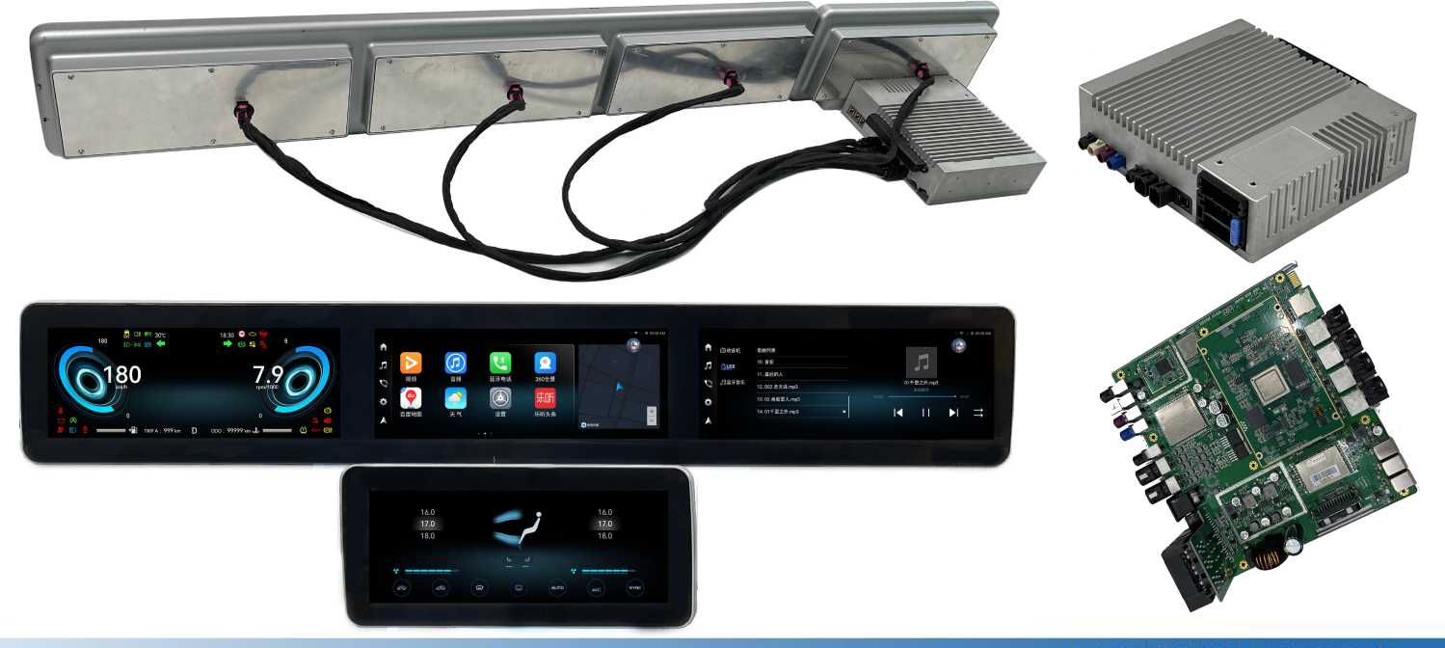
Demonstration of intelligent cockpit prototype

Slide 4

Smart cockpit live video
A four-screen intelligent cockpit

Slide 5
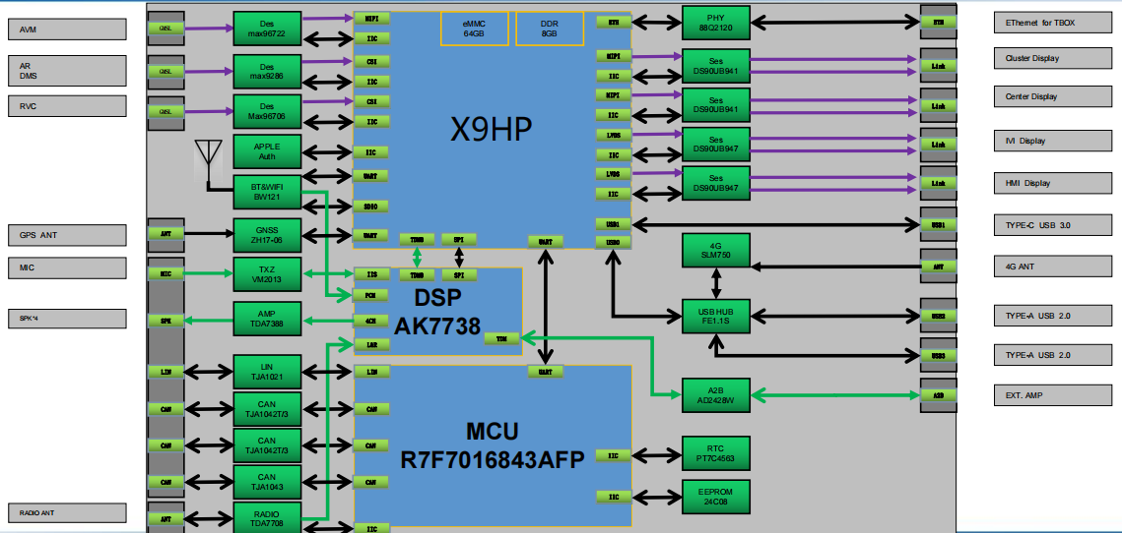
Intelligent cabin hardware block diagram

Slide 6
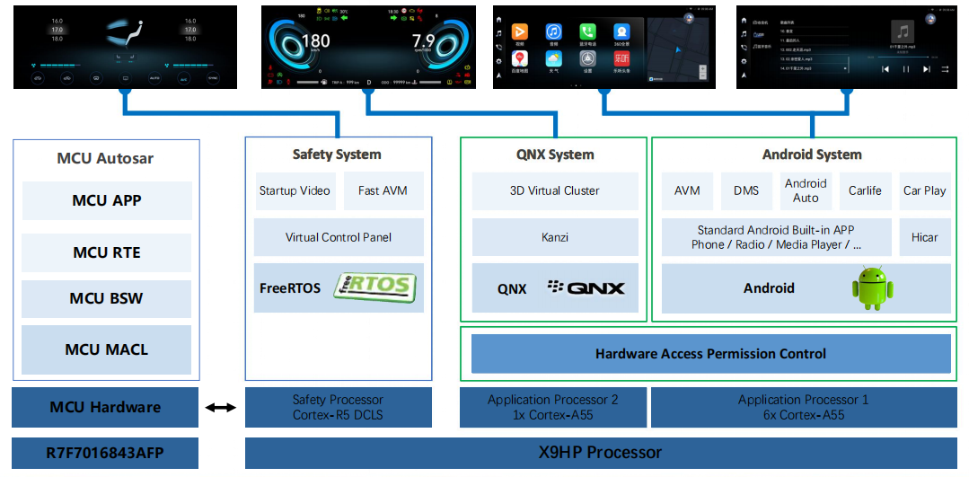
Intelligent cockpit system block diagram

Slide 7

Intelligent cockpit SOA software architecture
Service-oriented Architecture (SOA) is a perfect solution to the challenges of automotive software architecture.
SOA architecture: Features such as reusable, combinable and standardized service interfaces are conducive to the rapid introduction of new functions by Oems, flexible iteration, independent of hardware, operating system and programming language development mode is conducive to multi-party participation in software development, and the establishment of automotive ecosystem with OEM as the core.
Application Layer |  | Application |  | Application |  | Application
Service Framework |  | Service |  | Service |  | Service
 |  | SOA Middleware
Strata Intermedium |  | Application OS Android BSP |  | RTOS QNX BSP |  | Autosar Classic MACL
 |  | Other Middleware
Hardware Abstraction Layer |  | Device Agent DP/ Device Driver DD
Hardware Platform |  | ECU
functional safety

Slide 8
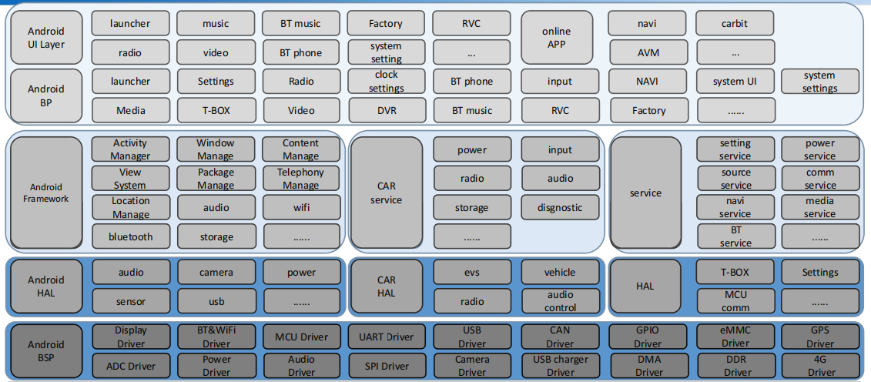
Android software block diagram

Slide 9
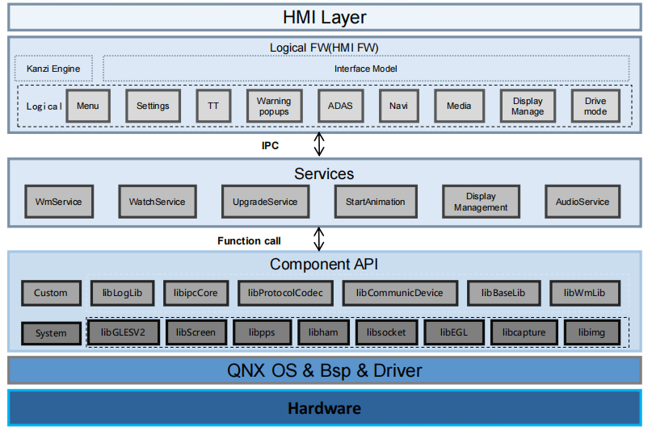
Instrument software block diagram

Slide 10
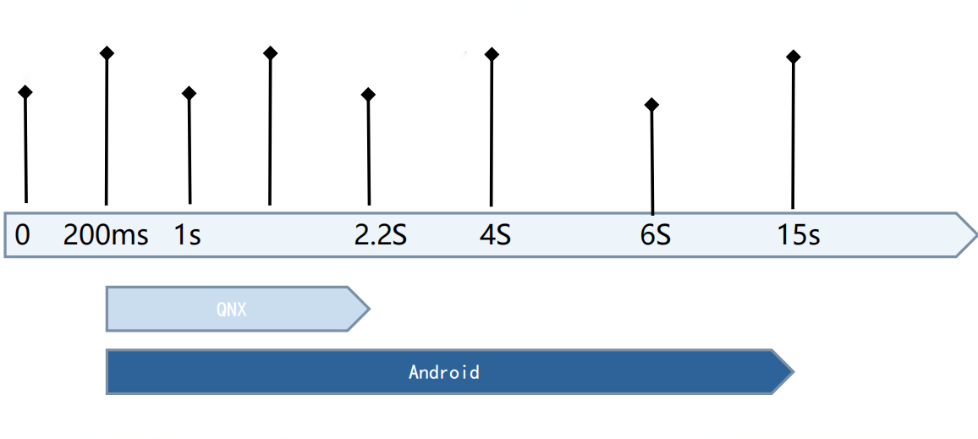
Power-on sequence diagram
MCU startup
RVC
Kernel startup complete
Android boot complete
Rouse
Backlight
Meter first frame
Start up animation

Slide 11
Chapter 1: Domain control hosts
Chapter 2: Main chip introduction
Chapter 3: IVI function
Chapter 4: Instrument function
Chapter 5: AVM functions

Slide 12
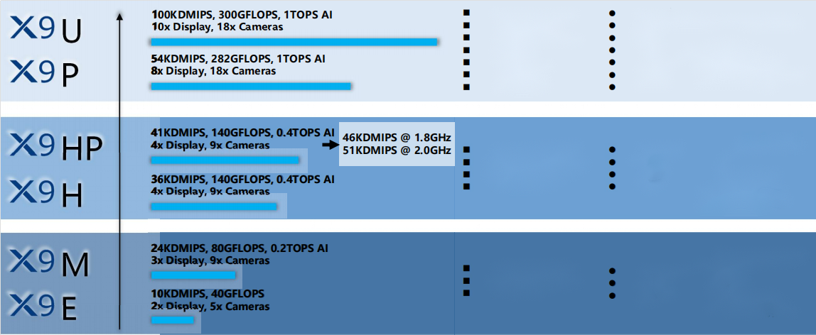
X9Series introduction
Linux/QNX meter
HUD
Android entertainment System
Copilot entertainment
Air conditioning panel x2
Back row Entertainment x2
Smart rearview mirror
360 view
DMS
OMS
DVR
Back vision
Rear x2
B-column x2
Flagship cockpit
8-10 screens
Android Central control +
Android Back row entertainment +
Linux/QNX meter
Main stream cabin
Linux/QNX meter
Android entertainment System
Copilot entertainment
Air conditioning panel
360 view
DMS
OMS
DVR
3-4 screens
Android Central control +
Linux/QNX meter
Economy cabin
FreeRTOS meter
Android entertainment System
Air conditioning panel
360 view
DMS
DVR
2-3 screens
Android Central control +
FreeRTOS meter

Slide 13
X9HPChip parameter
SemiDrive X9 HP (SoC) Chip process: 16nm process
CPU core: CPU ARM cortex-A55 *7 2.0Ghz+ Dual Cortex R5 @800Mhz 51K DIMPS
DDR: 32bit LPDDR4/LPDDR4X/ 4266MT/S
GPU： GM 9446+GM 9226 140GFLOPS
Video input： 2 MIPI CSI +1 8bit CSI
Video output： 4 Display controllable(MIPI 4 lane 2ch + Dual LVDS 2ch)
Video Codec： H.263/H.264/H.265/VP8/9/MPEG1/2/4/DIVX/WMV9/Real vedio/Theora/Avs
Storage : USB 3.0*2/ Emmc 5.1*2/SD 3.0 or SDIO*2/QSPI
Others： PCIE 3.0*2 /Ethernet/CANFD*2/Uart*16/SPI*8/l2C*16/ADC*4

Slide 14
Recommended key material list
No. | Items | Model Number | Supplier | Operating Temperature
1 | SOC | X9HP | Semidrive | -40°C~ + 125°C
2 | LPDDR 8G | K4UCE3Q4AB-KFCL03V | Samsung | -40°C~ + 105°C
3 | EMMC 64G | KLMCG4JEUD-B04P058 | Samsung | -40°C~ + 105°C
4 | MCU | R7F7016843AFP | Renesas | -40°C~ + 105°C
5 | AMP | TDA7388 | ST | -40°C~ + 105°C
6 | CAN | TJA1043/TJA1042 | NXP | -40°C~ + 150°C
7 | RADIO | TDA7708 | ST | -40°C~+85°C
8 | CSI | Max96722 | maxim | -40°C~ + 105°C
9 | PHY | 88Q2120 | Marvell | -40°C~ + 105°C
10 | link | DS90UB947 | TI | -40°C~ + 105°C
1 1 | DSP | AK7738 | AKM | -40°C~+85°C

Slide 15
Chapter 1: Domain control hosts
Chapter 2: Main chip introduction
Chapter 3: IVI function
Chapter 4: Instrument function
Chapter 5: AVM functions

Slide 16
IVISystem introduction
The central control IVI uses Android Q Automotive system,
Android Automotive is a basic Android platform Vehicle Infotainment system, referred to as IVI(In-vehicle infotainment), which is essentially an operating system running In the automotive infotainment system, it runs directly on the vehicle hardware. It is a full-stack, open source and highly customizable platform that powers automotive infotainment systems.
It supports apps built for Android, as well as apps built for Android Auto;

Slide 17

IVISystem introduction
The following key features are included:
AVM built-in algorithm, support 3D model,
Built-in radio chip, support RDS function,
Intelligent speech recognition, local speech recognition + online speech recognition,
DSP sound algorithm, support third party sound algorithm,
RVC function, support reverse trajectory, radar signal superposition,
Built-in power amplifier, can support 8 built-in power amplifier, support vehicle acoustic alarm system AVAS,
Built-in A2B chip connected to external power amplifier, support TDM8 output, sound strategy is more flexible,
Built-in 4G or 5G communication module, support soft TBOX function,
Multi-language switching, such as Chinese/English, support to expand multiple language packages,
Bluetooth phone function, phone book synchronization, call name display, __
Mobile screen projection function, support Yilian, Hicar, CarLife and car factory customized mobile Internet;
Support OTA upgrade, through the built-in 4G or 5G communication module, Ethernet connection TBOX upgrade

Slide 18
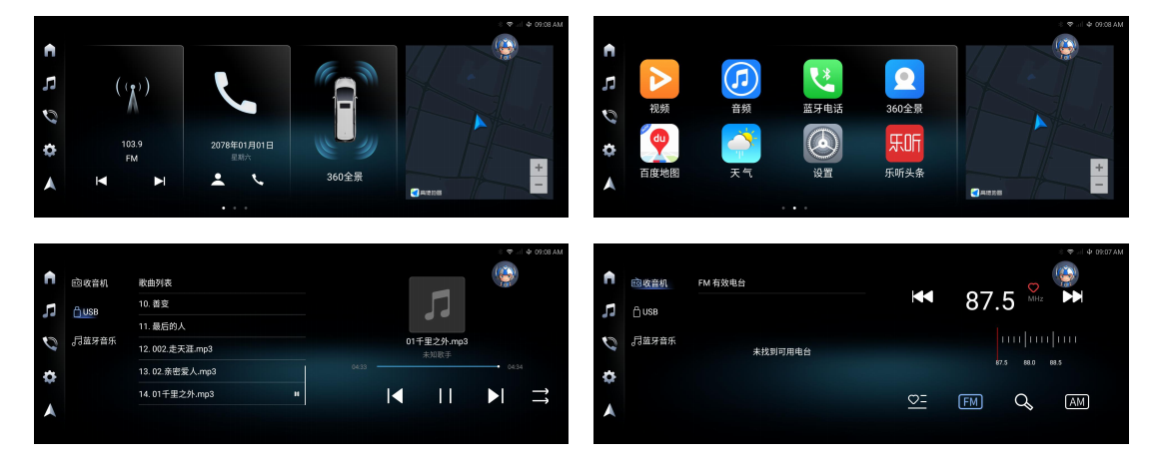

Slide 19
Chapter 1: Domain control hosts
Chapter 2: Main chip introduction
Chapter 3: IVI function
Chapter 4: Instrument function
Chapter 5: AVM functions

Slide 20
Introduction to instrument system
Instrument with QNX system +kanzi HMI tool:
1. QNX is one of the most mainstream operating systems in the field of automotive instrument systems, with the characteristics of safety, reliability, high stability, open source, portability, etc.
2. Kanzi is a cross-platform HMI tool that combines high-end 3D models with functions of automotive UI frameworks such as digital instrument sets and infotainment systems. First-tier automakers at home and abroad use kanzi for instrument development in large quantities.
3. X9HP chip CPU, GPU support 3D rendering graphics library, 2D hardware acceleration and other functional modules;

Slide 21
Instrument function introduction
The following key features are included:
Smooth startup animation, indicator self-test process, dial pointer rotation,
The speedometer, tachometer, fuel meter, water temperature meter and dynamic effects of speed are all designed with 3D model, which can render any position in real time, and the pointer can rotate smoothly without delay, which can reach 60 frames.
2 sets of theme switching, switching with transition animation, convenient for subsequent expansion of multiple sets of themes,
Support multi-language switching, such as Chinese/English, to facilitate the subsequent expansion of multiple language packages,
Support Bluetooth phone interaction function,
Support mobile phone projection function, can do 1920*720 full screen navigation,
Support OTA upgrade, convenient for subsequent software upgrade,
Can support 3D model rendering, the effect is cool, enhance the sense of science and technology, bring users a sense of freshness,

Slide 22
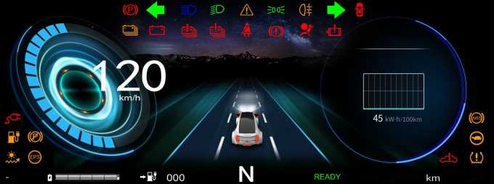
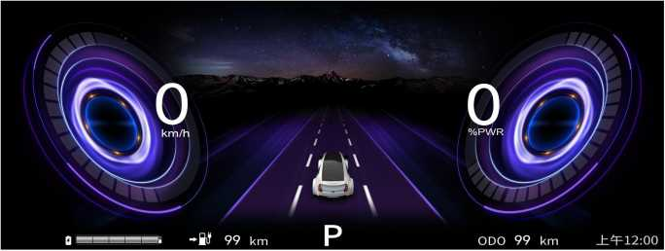
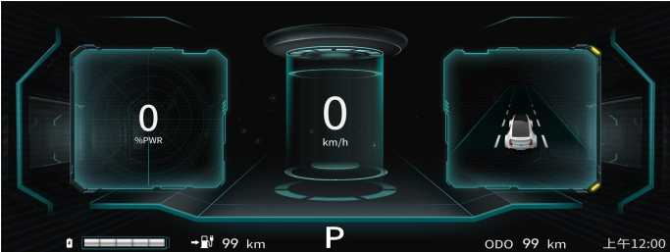
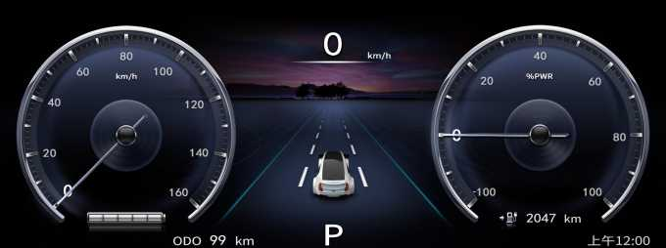
Instrument Ul display
常显信息
瞬时能耗
长按0K重置
oo°c
km
ODO 000000
00:00

Slide 23
Chapter 1: Domain control hosts
Chapter 2: Main chip introduction
Chapter 3: IVI function
Chapter 4: Instrument function
Chapter 5: AVM functions

Slide 24
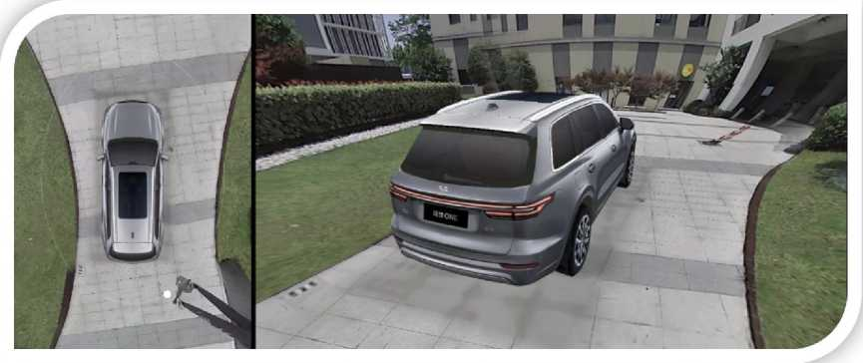
Description of AVM functions
AVM circumnavigation system can provide the video effect of no blind area around the car body during the driver's driving process, the driver can intuitively see the position of the vehicle and the obstacles around the vehicle, and control the vehicle to park or pass through the complex road surface, effectively reducing the occurrence of scratches, falls, collisions and other accidents.
Integrated with the ADAS advanced driver assistance system, it senses the environment around the vehicle and the vehicle through sensors and cameras, providing the driver with reliable alarm and prompt information, making the driving safer.

Slide 25
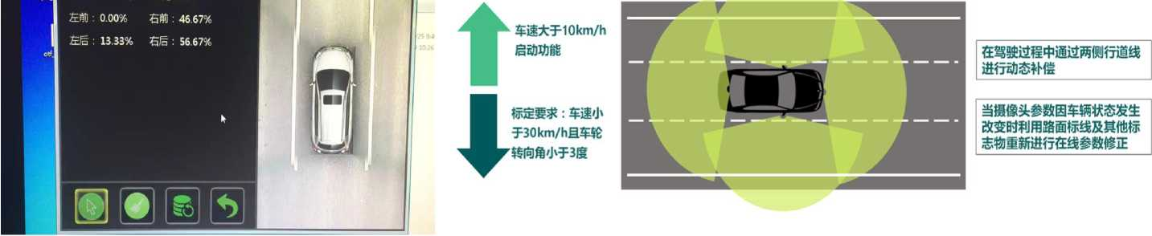
Description of AVM functions
Off-line calibration (traditional scheme)
When the vehicle is off the line, the calibration site is arranged in advance, and the system completes the calibration of the camera by automatically collecting the site information.
On-line Calibration (OTF)
When the camera is replaced or the installation position is slightly offset. The system can complete the calibration of the camera by automatically collecting the surrounding scene information, without the need to calibrate the camera by a specific calibration site.
在线标定

Slide 26
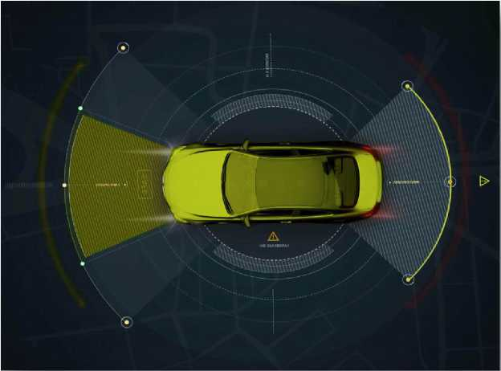
Description of AVM functions
•Moving object monitoring(MOD)
Through the four-way fisheye camera to identify the moving objects around the body, detect the surrounding environment
•Pedestrian Detection(PD)
Through the analysis of the image information collected by the camera, the stationary or moving pedestrians (adults, children, etc.) are detected and alerted
•Lane departure warning(LDW)
Detect the road space behind and on the side of the vehicle and give the driver a warning when the vehicle is approaching
•Blind spot detection system(BSD)
Through the left and right rear three language camera monitoring, monitoring the rear obstacles of the vehicle timely alarm signals and avoid traffic accidents

Slide 27
contact information
Sales Director: Chang Jing Mobile: Email:paula@szzest.com
Product Manager: Liu Wei Mobile:
Email:

Slide 28

Look forward to cooperating with you!

